Slide 1
SRI SHAKTHI INSTITUTE OF ENGINEERING AND TECHNOLOGY
Dynamic AI Medical Guardian
Offline-First USB Medical AI & Emergency Guardian
Team Leader: Sahira Fathima I
Team Members: Nethraa N, Mogith R, Seenivasa Maya K
Notes:
1

Slide 2
Problem Statement & Proposed Solution
Problem
Solution
Smart healthcare depends on cloud servers, so network dropouts, remote travel or golden-hour emergencies can cause total failure.
A portable, offline-first USB web application and AI guardian that runs locally or on secure standalone nodes, with no need for continuous cloud connectivity.
Sensitive data such as prescriptions and blood markers is exposed on vulnerable cloud platforms.
Notes:
2

Slide 3
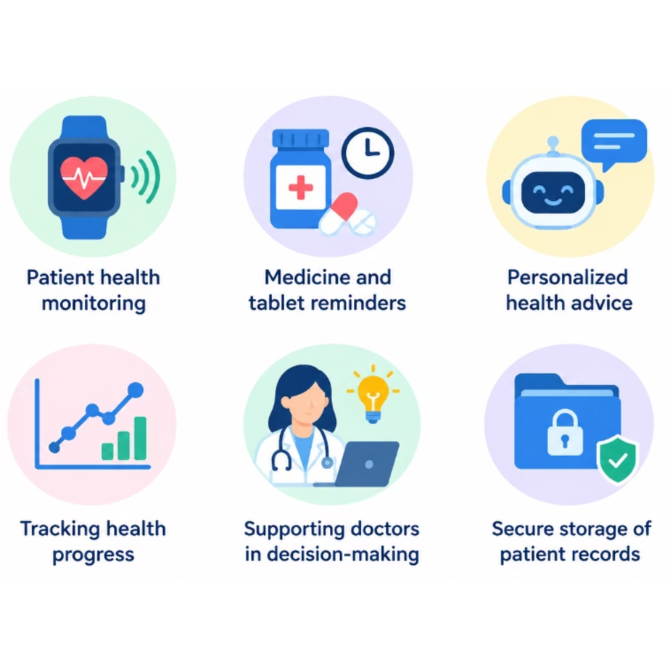
Healthcare Uses
Medical Information Management
Organized medical records in one place.
Medicine Schedule Tracking
Timely reminders for every dose.
Weekly Reports
Summaries of medicine and health logs.
Emergency Dossier Access
Restricted access with PIN separation.
Voice & Text Interaction
Hands-free use by voice or text.
Multilingual Accessibility
Support for diverse patients.
Privacy-Focused Local Handling
Sensitive data stays on the device.
Caregiver & Emergency Contact Support
Keeps caregivers and contacts informed.
Medication Adherence Review
Tracks adherence over time.
Notes:
3

Slide 4
Technical Stack & AI Architecture
Frontend & UI
AI, Voice & Languages
HTML5 for structure; CSS3 for responsive dark-theme styling; JavaScript for navigation, PIN validation, medicine records, language selection, themes, reports, and emergency workflows.
Compatible local language model plus an inference runtime for offline responses; voice input and text-to-speech through supported speech technologies or offline engines; English, Tamil, Tanglish, Hindi, Malayalam, and Telugu, subject to model and speech-engine support.
Security & Data
Hardware, Portability & License
Emergency PIN 1999; personal PIN 7777 or custom PIN; local prototype storage. Real medical data requires encryption and a secure database.
USB-based project files, model, and data; Android integration for floating controls, notifications, background services, and USB events. Verify the final model and runtime licenses before deployment.
Notes:
4

Slide 5
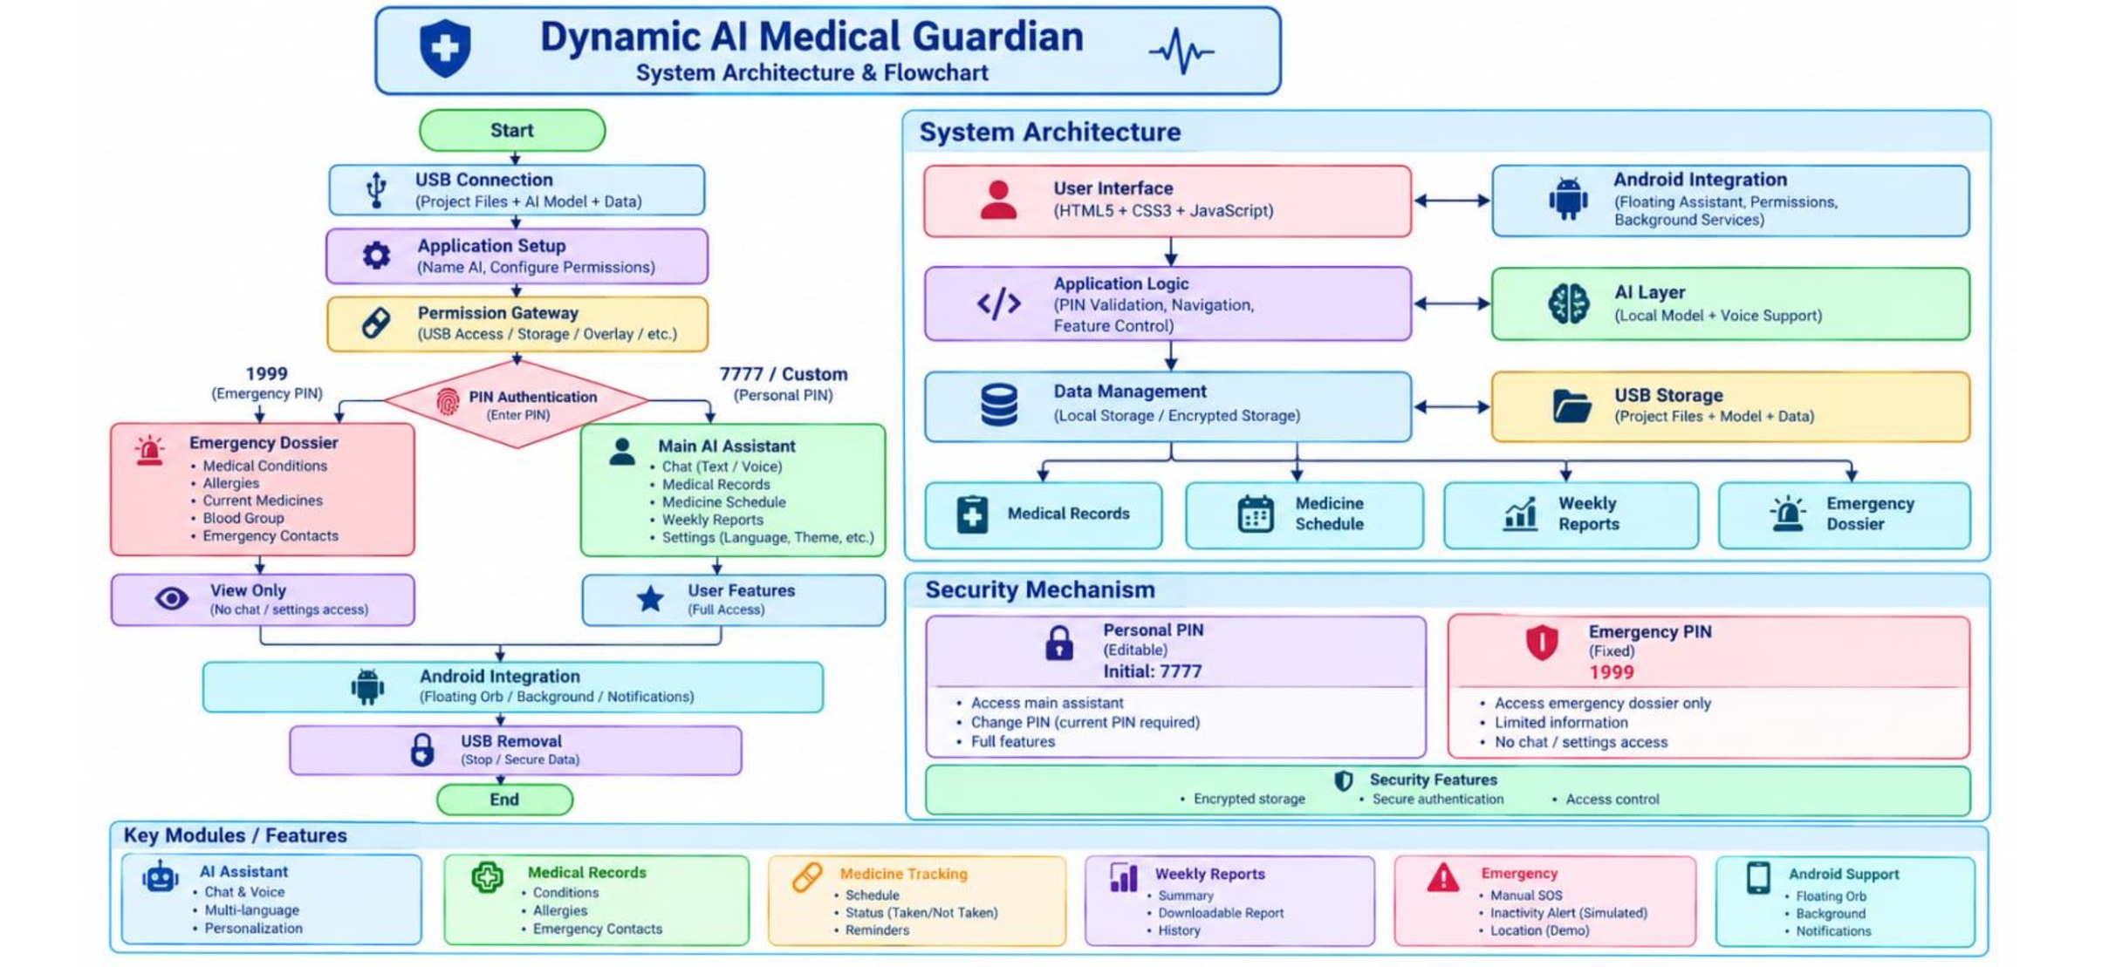
System Architecture & Workflow Diagram
Notes:
5

Slide 6

Feasibility, Viability & Impact
Feasibility
Viability
Social Impact
A lightweight single-file bundle (index.html) that runs directly from a USB flash drive or local storage, with no server dependency.
An open, scalable architecture that can integrate local hardware sensors (gyroscopes, smart watches) and local LLMs for true offline portability.
Secures the golden hour, bridges language barriers for responders through regional Indian languages, and protects patient privacy.
Notes:
6

Slide 7
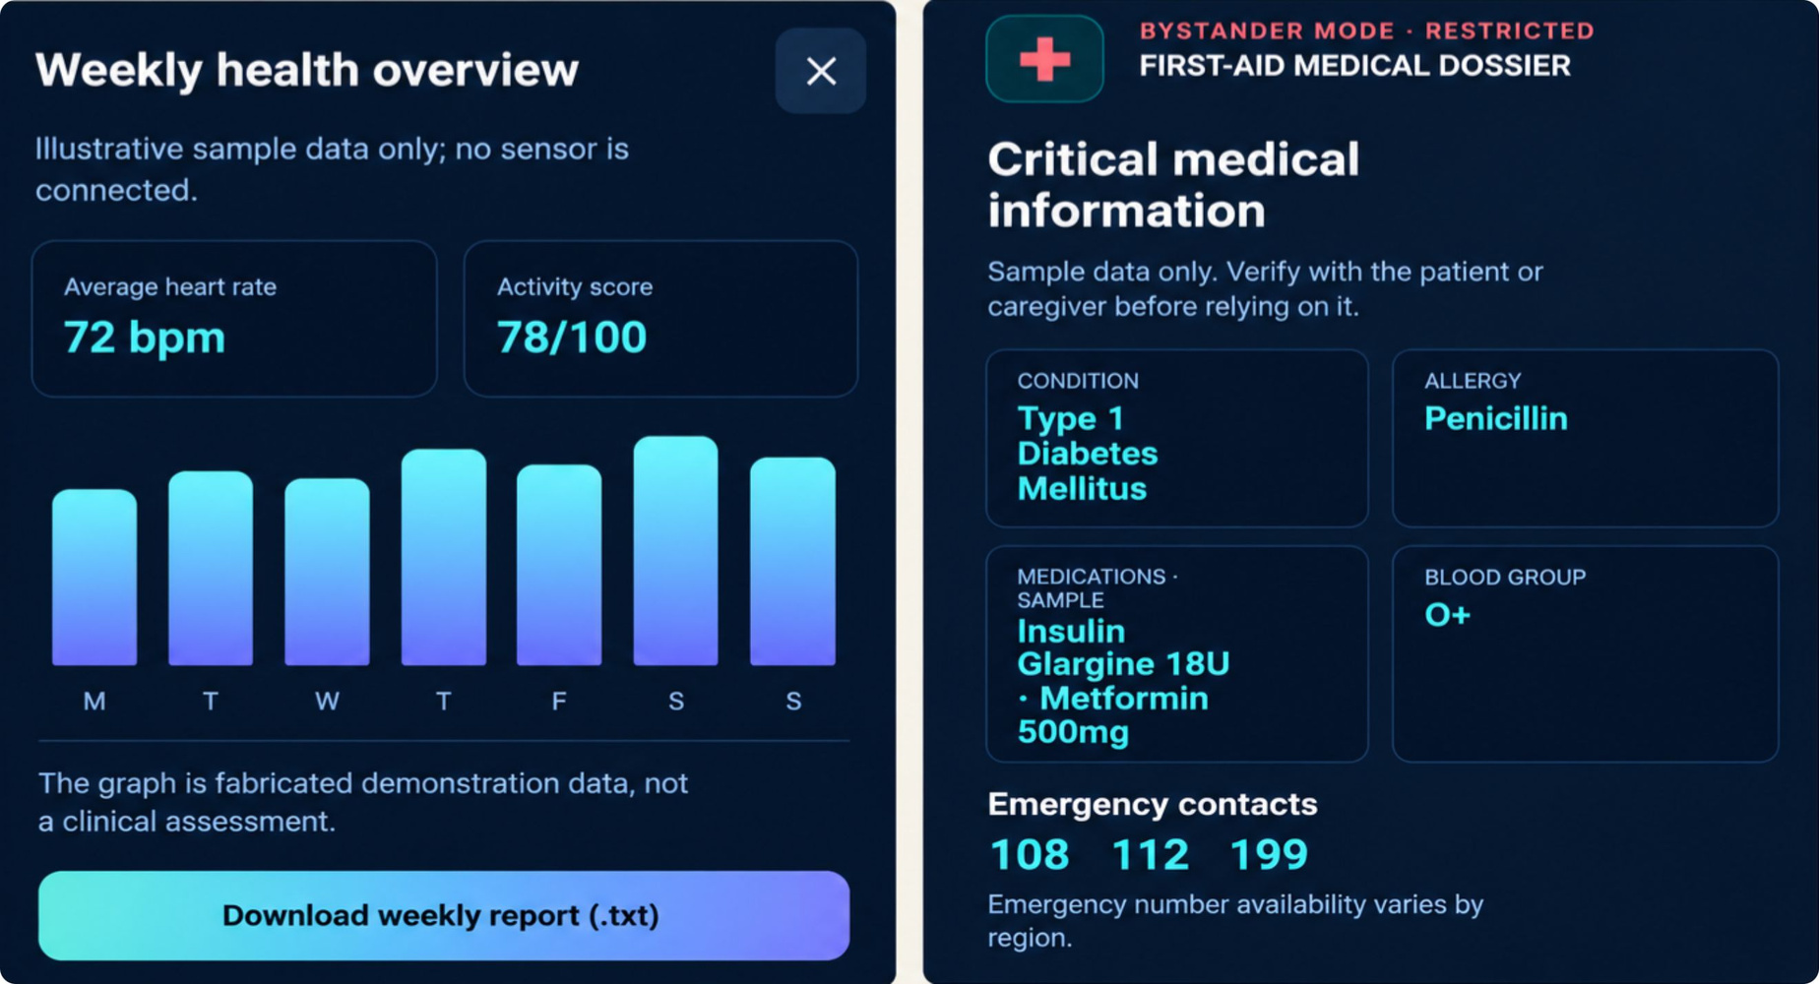
Project Outcome
Values shown are illustrative prototype data only.
Notes:
7

Slide 8
Thank You!
“Securing Lives, Offline & Anywhere.”
Incubator / Faculty Support
Mahendar Raju
Embedded Trainer, CDC
Assistant Professor, ECE
Notes:
8

